Slide 1


CINERGY® Conflict Management
Coaching Workshop
providing a well-researched and highly effective coaching process
This comprehensive workshop will equip you with the essential knowledge and tools to effectively coach people, on a one-on-one basis, to manage and engage in their interpersonal disputes. You will also gain increased understanding about several conflict concepts and strengthen your insights | about the dynamics that commonly lead to disputes. Elevate your expertise, in whatever capacity you work with people in conflict, by learning a unique model for coaching others to gain increased competence and confidence to more effectively manage their conflicts.
When you enroll in the CINERGY® Conflict Management Coaching workshop you can expect to:
learn the coaching, conflict management and neuroscience pillars of the unique CINERGY® model; gain the knowledge and skills to add conflict management coaching to your toolbox; learn the unique 7 step CINERGY® model of conflict management coaching that methodically guides recipients to gain the insights and perspectives to help them take action and reach their goals; | discover the transformative impact of conflict management coaching in both personal and professional contexts; differentiate conflict management coaching from other modalities and dispute resolution techniques, while gaining an understanding of its unique strengths and applications; and consider logistics, marketing ideas and other practical tips for providing this process
What is Conflict Management Coaching? | Conflict management coaching, also known as conflict coaching, is a specialized niche in the field of coaching and conflict management. It is a process in which a trained coach assists people on a one-on-one basis to effectively manage their interpersonal disputes and enhance their conflict management skills. This technique may also be used to coach people to more confidently and effectively participate in mediation, negotiation and other dispute resolution techniques.
Methods Used in the Workshop
Through practices, demonstrations, self-reflection and discussion, participants develop and practice conflict management coaching techniques and skills.
Participants
The training will be of specific interest to coaches, workplace, family and other mediators (interpersonal conflicts), HR Professionals, lawyers, leaders and others who work with people in conflict.
Following the Conflict Management Coaching Workshop, participants who complete the workshop may choose to receive a free monthly newsletter called “CINERGEMS” and attend a ‘teletalk’ on conflict management coaching practice topics held monthly by CINERGY® at no cost.

Slide 2
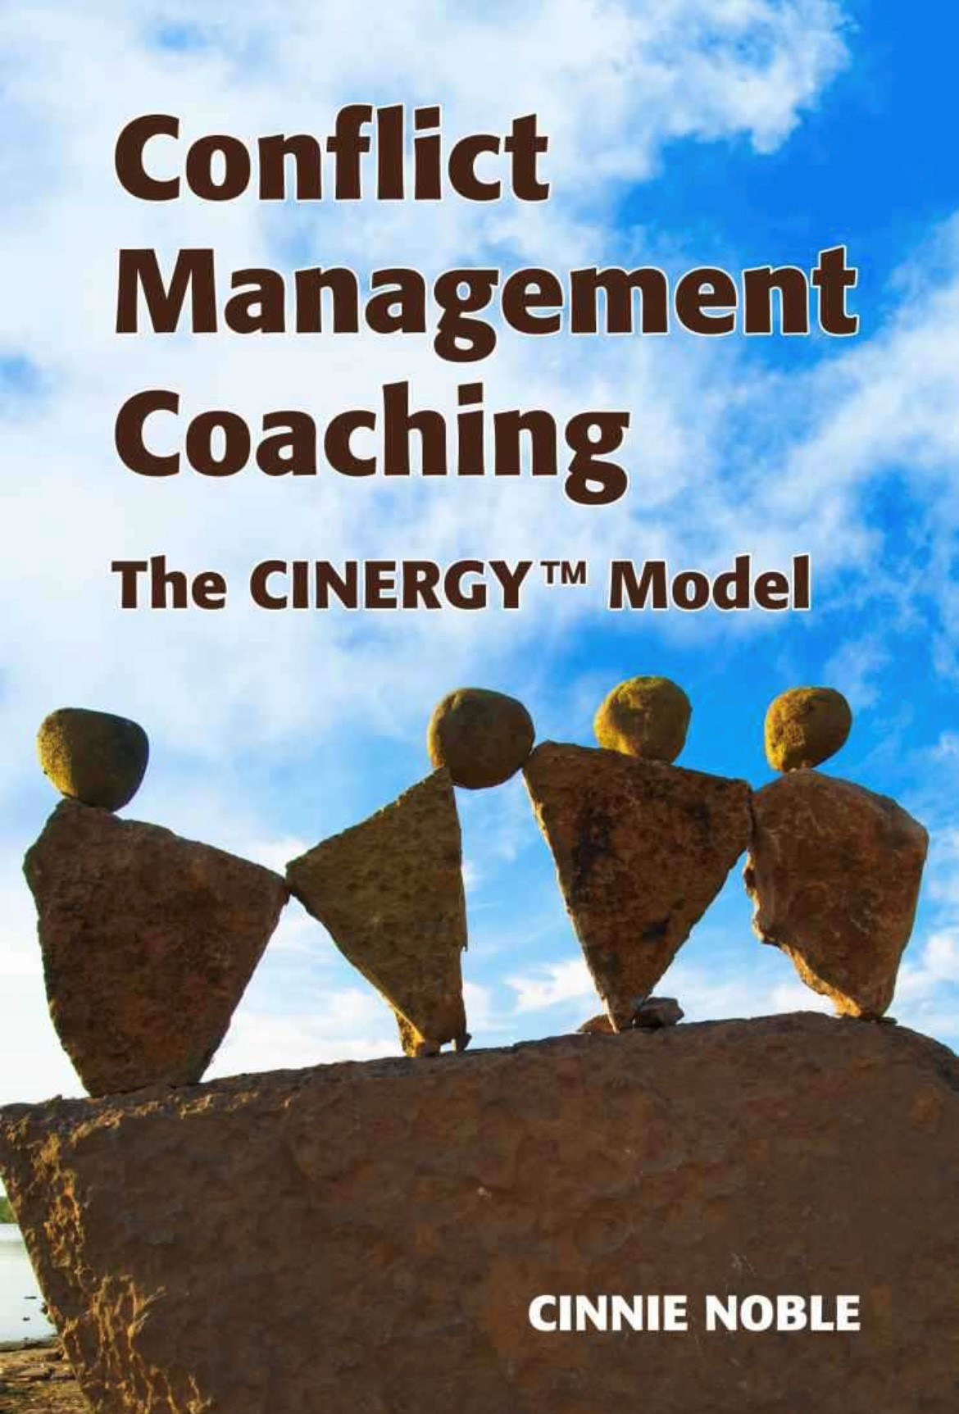
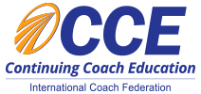
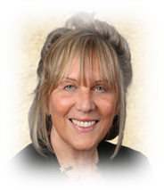
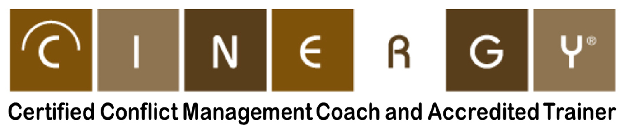

For over 20 years thousands of people have been trained around the world - virtually and in-person - in the unique and highly effective CINERGY® model of conflict management coaching | The CINERGY® model is a 7-step process that seamlessly blends the principles of conflict management, coaching, and neuroscience to transform how individuals approach and manage conflict. For over two decades, thousands of people worldwide have learned this unique methodology, empowering them to navigate conflict with greater confidence, competence, and effectiveness.
Workshop Dates: | August 4 - 20, 2026 (see Session Schedule for details) Registration deadline July 4, 2026
Cost: | $2,700.00 CDN/person (+13% HST* = $3,051.00 CDN) $2,450.00 US/person
(*HST applicable to Canadian registrants)
The CINERGY® conflict management coaching workshop has been approved and certified by the International Coaching Federation (ICF). Participants who successfully complete this program will receive continuing education credits that can be applied towards any ICF coaching designation.
Participants are required to purchase the book “Conflict Management Coaching: The CINERGY Model” available at major book stores.
Take your conflict management skills to the next level and make a positive impact on the lives of others.
Cinnie Noble - your workshop instructor
Cinnie Noble is the founder of CINERGY® Coaching, a division of Noble Solutions Inc. A former social worker and lawyer, Cinnie is a Chartered Mediator (C.Med) and certified coach (PCC) who has studied and practised a range of conflict management services for over 25 years. Cinnie is a much sought-after speaker and regularly presents nationally and internationally, on conflict management coaching related topics and the many applications of this process. Cinnie is also the author of “Conflict Mastery: Questions To Guide You” and “Conflict Management Coaching: The CINERGY™ Model”.
Cinnie Noble
cinnie@cinergycoaching.com
www.cinergycoaching.com

